Slide 1
Knock out, knock down, knock in
Genetic engeneering –
genome editing
2018.11.26

Slide 2
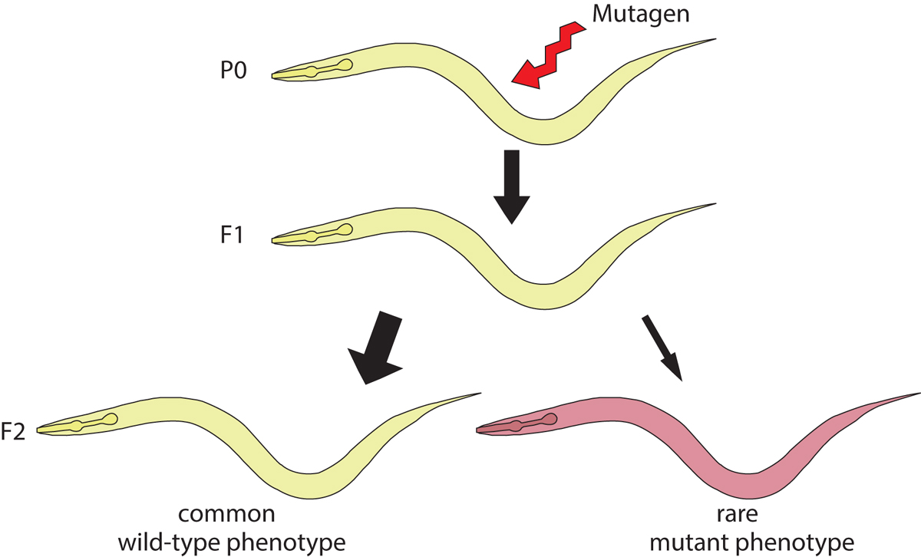

Problems with classical mutagenesis (forward genetics):
laborious
paralogous gene families (functional redundancy) – the function of several genes remains undetectable by random mutations.
Genomics – allele generation, starting from nucleotide sequence information: RNA interference (reverse genetics)
From 1995

Slide 3
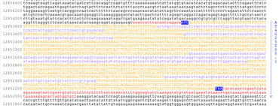


Slide 4
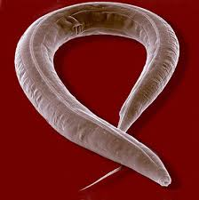
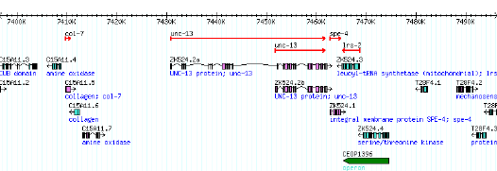
C. elegans Gene Knockout Consortium
Konckout
Mutant (deletional) allele for every gene
PCR-based
-mutagenesis
-using specific primers, „screening for short” (deleted) fragments– PCR preferable ampl
Ify short fragments instead of long ones.

Slide 5
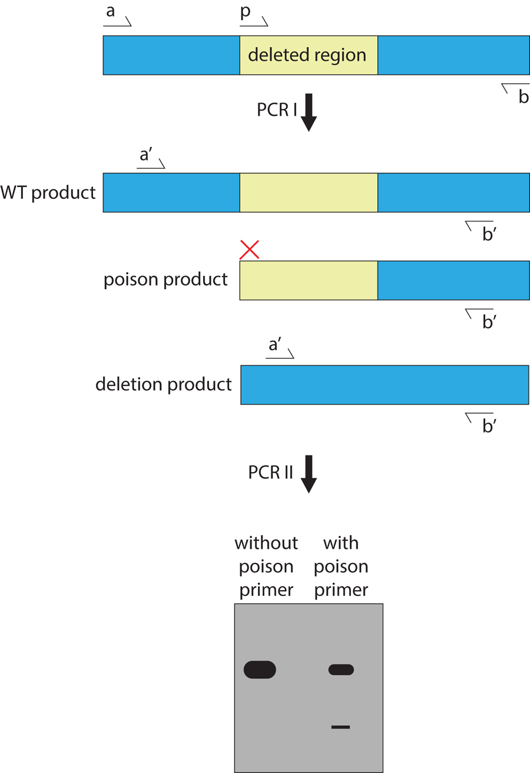
Random mutagenesis (EMS)
Directed screen for PCR deletions
Isolation of homozygous mutants
Phenotype chracterization

Slide 6
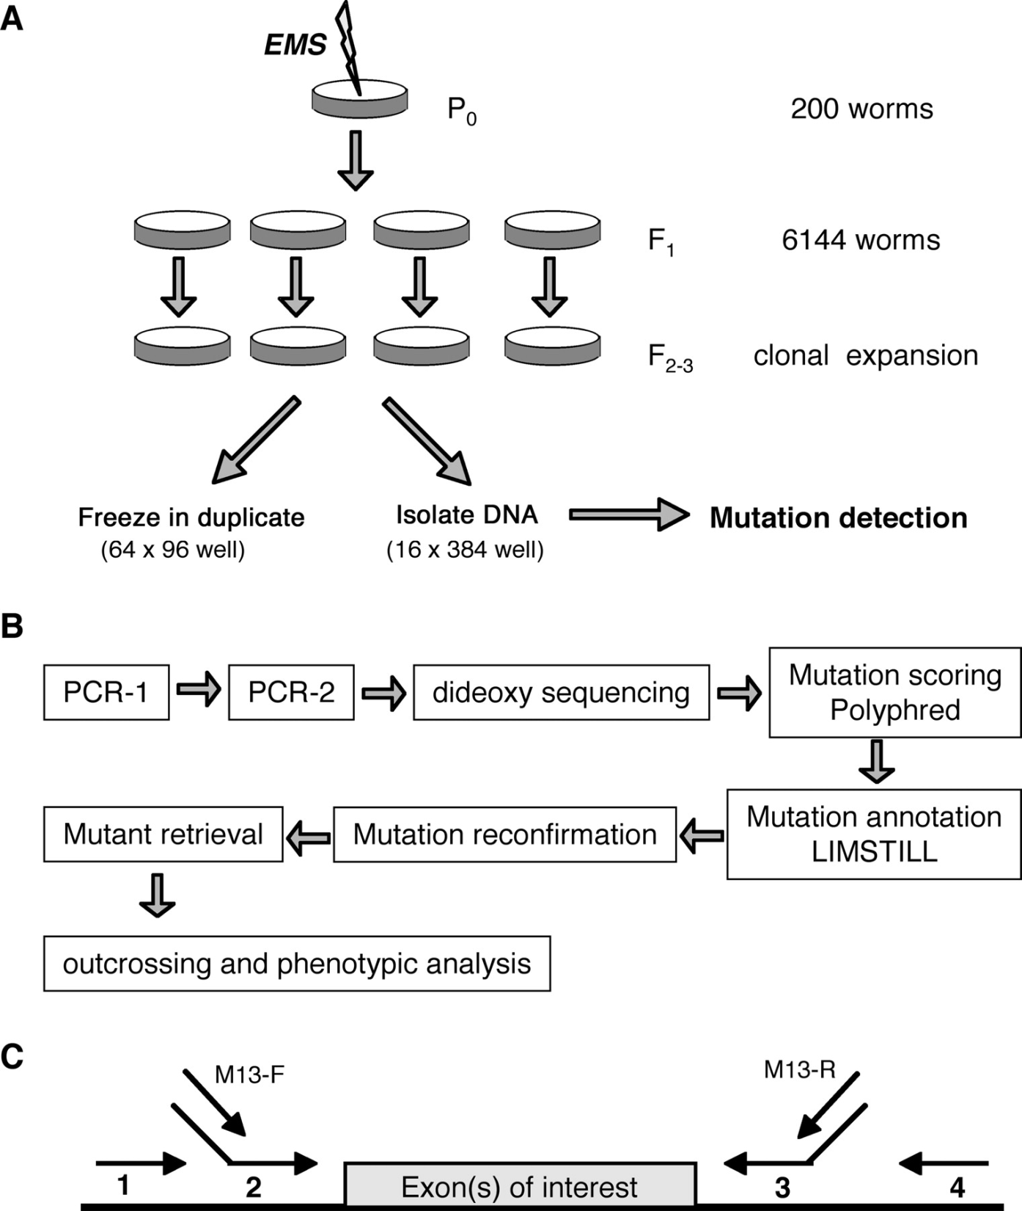
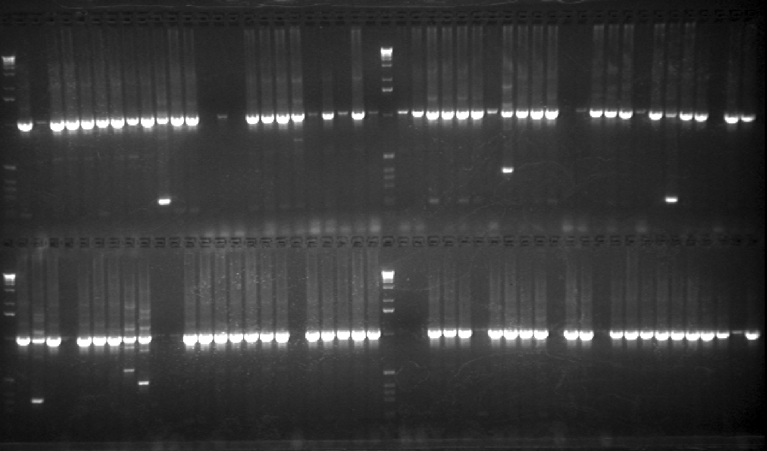

Slide 7
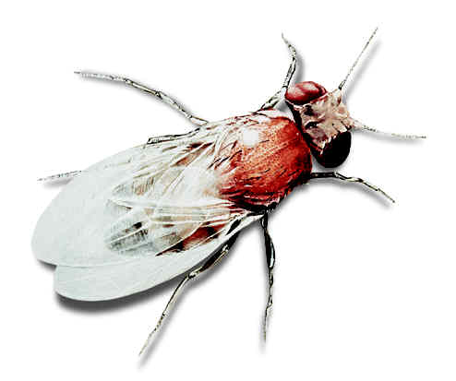
Drosophila mutagenesis:
a P element-based approach (knock in)
31 bp IR
31 bp IR
CATGATGAAATAACATAAGGTGGTCCCGTCG
CGACGGGACCACCTTATGTTATTTCATCATG
1
31
2877
2907
Genetika
11 bp IR
11 bp IR
ATTAACCCTTA
TAAGGGTTAAT
126
136
2763
2773
IR
ORF 0
ORF 1
ORF 2
ORF 3
IR
1
85
442
501
1168
1222
1947
2138
2706
2907
Intron 1
Intron 2
Intron 3

Slide 8
Generation of insertional alleles by P element mobilization
transposase
P element
target gene
Neighbouring gene
target gene
Neighbouring gene
PCR primer: sequencing

Slide 9
Generatiuon of deletions by P element remobilization
transposase
P element
Gene of interest
Neighbouring gene
deletion

Slide 10
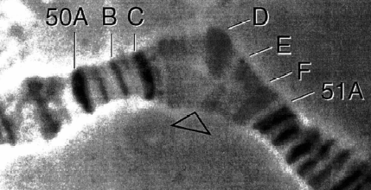
Identification of deletional mutants
Based on phenotype: in essential genes (causing lethality)
PCR: the size of deleted region can be determined
PCR primer
Wild-type
mutant
P element
vizsgált gén
deletion
PCR primer
loop in the heterozygote

Slide 11
Generation of transgenic flies by P element microinjection
DNA region destined for cloning is inserted between two inverted repeats of P element in a plasmid, which is injected in the presence of a transposase-encoding sequence into a M cytotype embryo at the pre-blastema stage.
EcoRI, KpnI, BamHI, XbaI, HpaI, XhoI, PstI
Cloning site
Bacterial sequence
white
5’-end
Hsp70
3’-end
Transposase can be derived from:
- purified transosase protein linked to a plasmid
- co-injecting with a „helper” plasmid
- injecting into a fly containing endogenous transposase

Slide 12
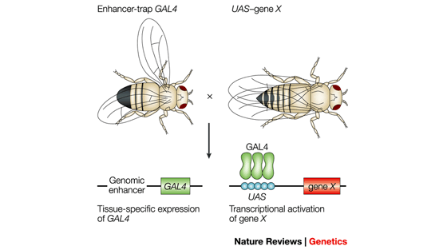
Gal4-UAS system in Drosophila
own (endogenous) promoters in Drosophila have usually weak (undetectable) activity. In C. elegans however promoters are strong enough to provide detectable levels of expression – there is no Gal4-UAS system)
The importance of genomic environment

Slide 13
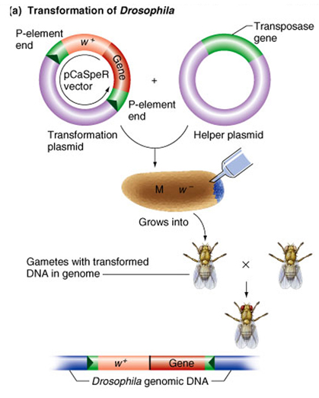
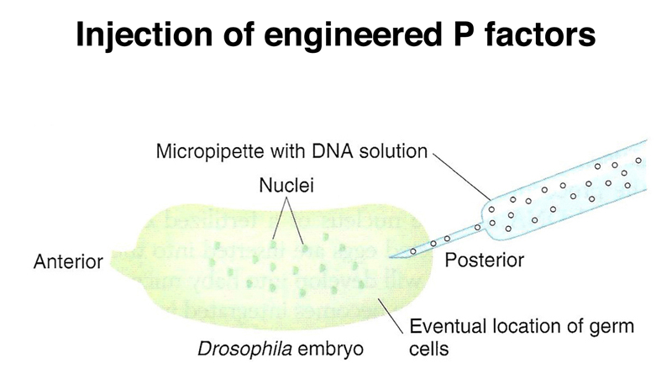
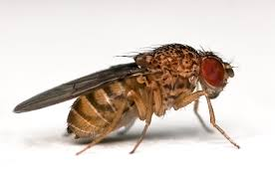
Transformation
Knock in
Sensory neurons in Drosophila larva, reporter GFP gene

Slide 14
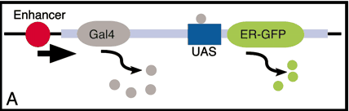
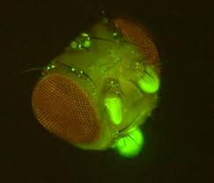
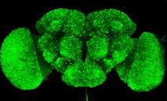
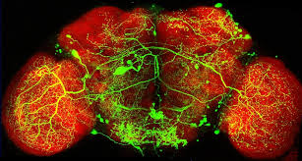
Drosophila brain stem

Slide 15
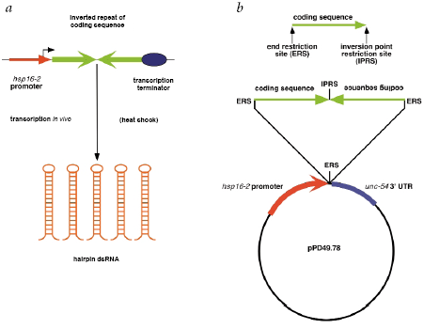
Knockdown: RNA interference libraries – C. elegans, Drosophila

Slide 16

RNA interference libraries - Drosophila
Eyeless RNAi

Slide 17
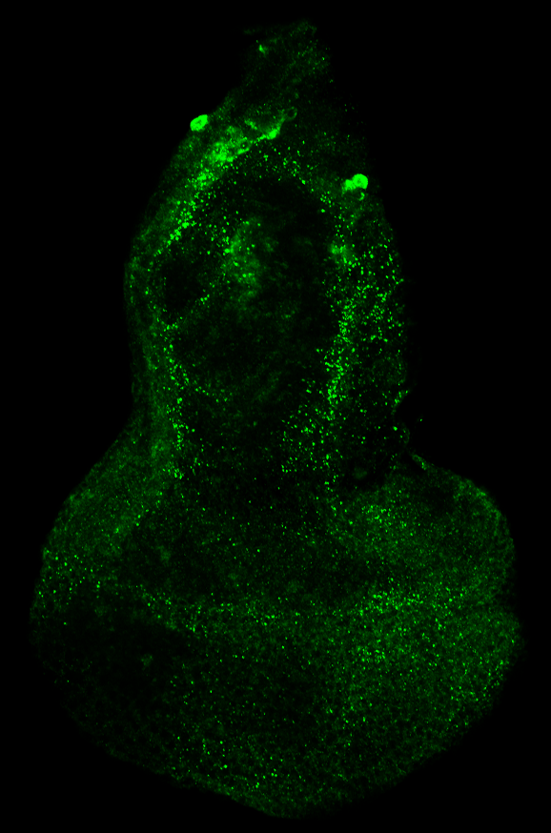
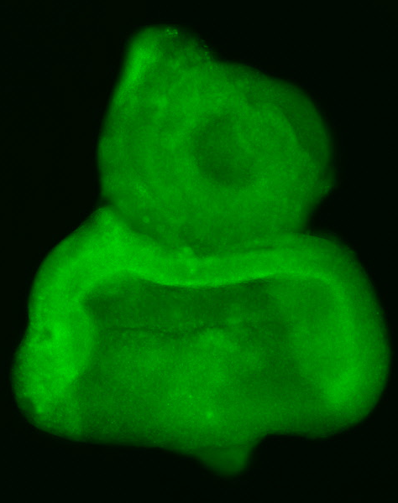
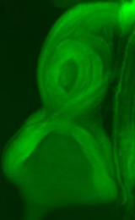
Endogenous expression of a Drosophila gene, Atg8a
eGFP-Atg8a-A
5’UTR
eGFP
Atg8a-A coding region
3’UTR
BamHI
HpaI
XhoI
XbaI
Confocal microscopy
Szemdiszkusz
Anti-Atg5
58A
Anti-Atg8a
eGFP-Atg8a-A
Antibody staining
Fluorescence microscopy

Slide 18
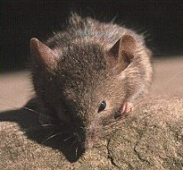
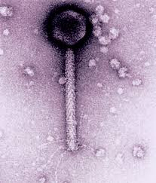
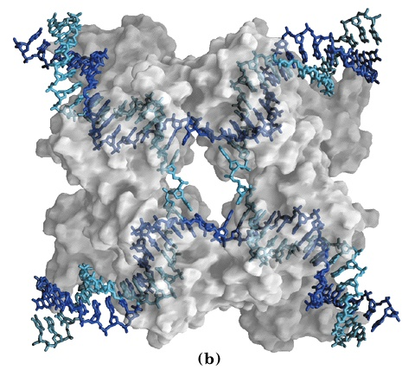
Mutagenesis in mice: Cre-loxP system
Relies on P1 phage homologous recombination system: (Cyclization of REcombination)
Mus musculus
palindrom spacer palindrom
Cre recombinase

Slide 19
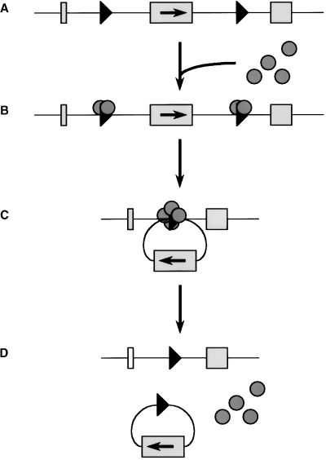
Cre-loxP system
loxP
loxP
Cre recombination
deletion

Slide 20
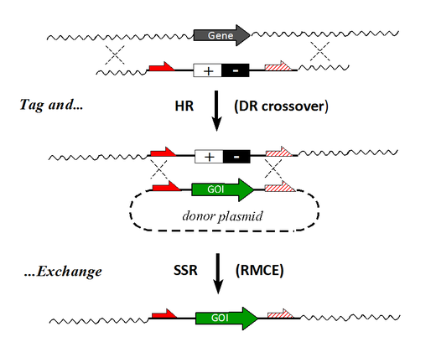

Slide 21
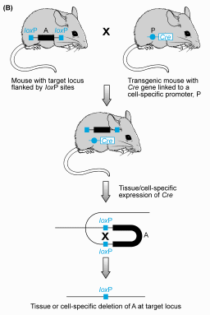
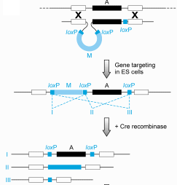
Cre-loxP system: knockout mice

Slide 22
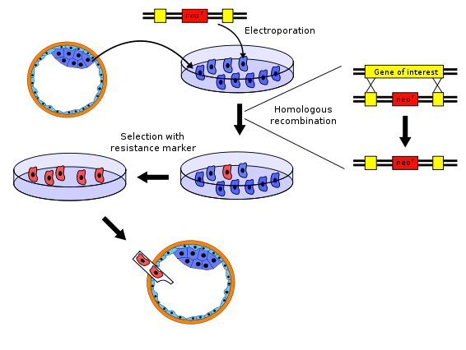
Transgenesis in mice I.
Vector DNA
blastocyst
Chromosomal DNA

Slide 23
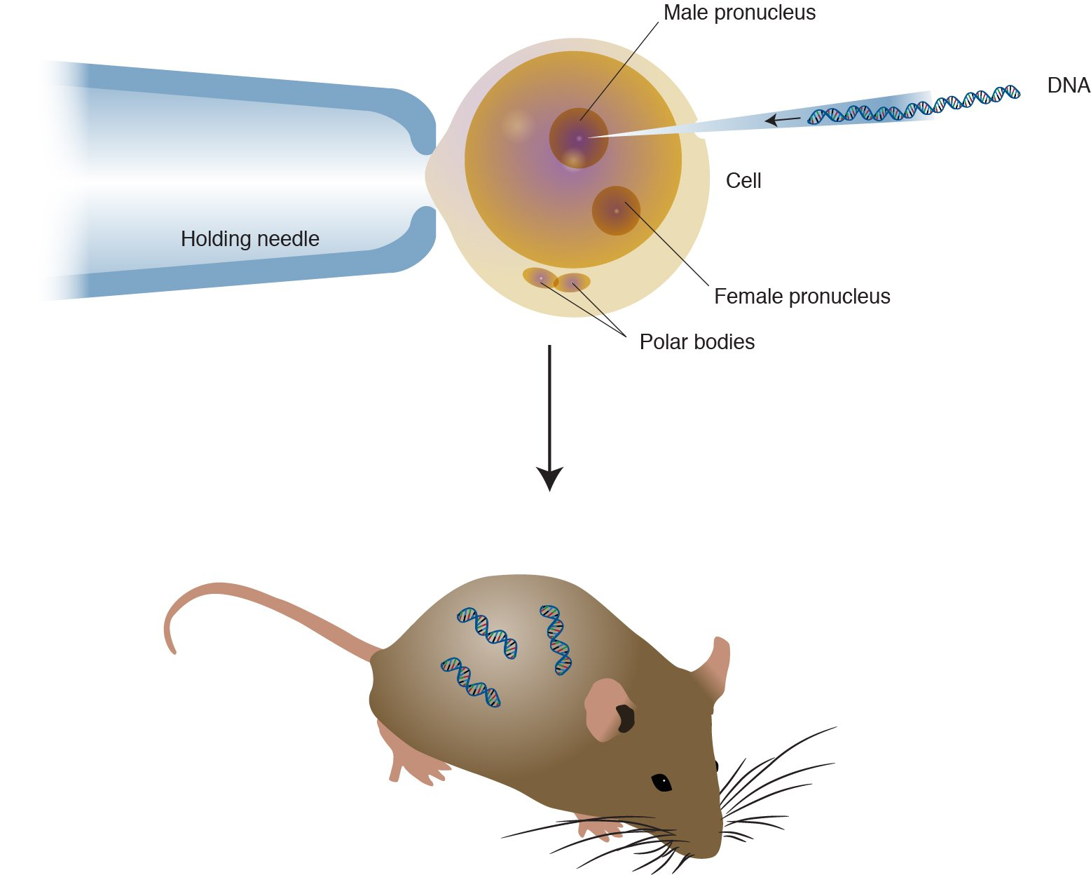
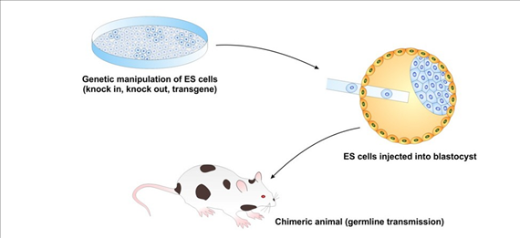

Slide 24
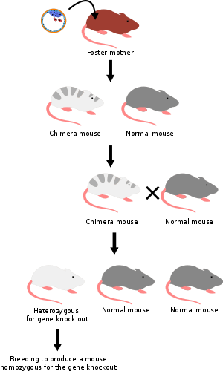
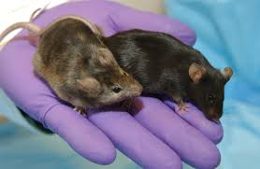
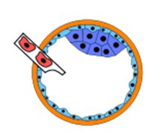
Transgenesis in mice II.
F1
(transformation not in zygote)

Slide 25
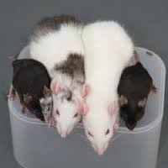
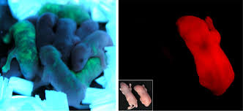
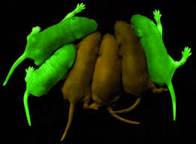
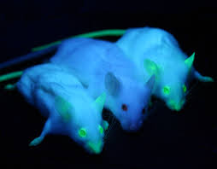
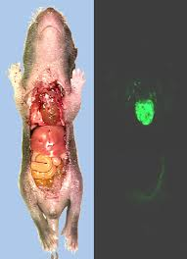
Homozygous transgenic mice

Slide 26
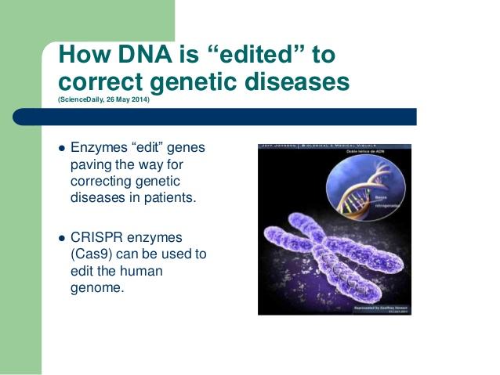
DNA editing: major goals

Slide 27
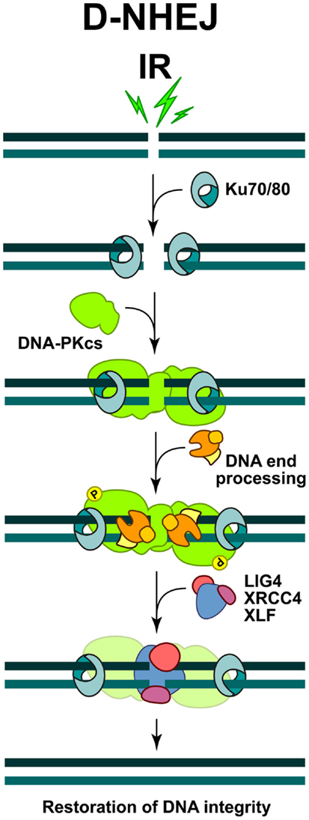
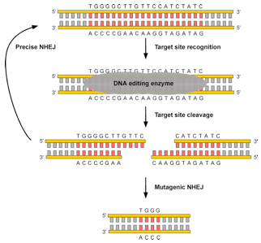
Targeted knockout DNA editing with enzymes
NHEJ: non-homologuous end joining

Slide 28

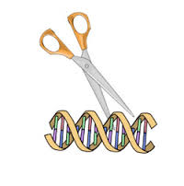
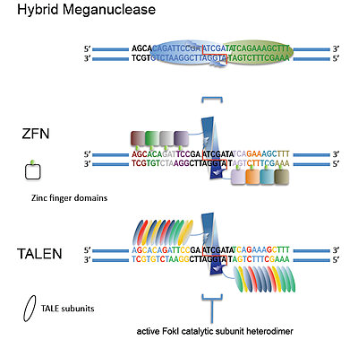
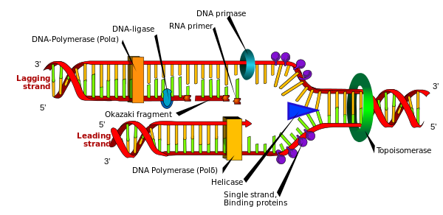
DNA editing enzymes
Transcription activator-like effector nuclease

Slide 29
Programmable nucleases
zinc-finger nucleases (ZFNs)
transcription activator-like effector nucleases (TALENs)
RNA-guided engineered nucleases (RGENs) derived from the bacterial clustered regularly interspaced short palindromic repeat (CRISPR)–Cas (CRISPR-associated) system

Slide 30
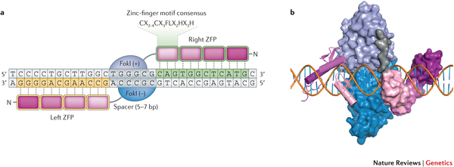
Each ZFN is composed of a zinc-finger protein (ZFP) at the amino terminus and the FokI nuclease domain
ZFNs typically contain between three and six individual zinc finger repeats and can each recognize between 9 and 18 basepairs. The zinc finger domains perfectly recognize a 3 basepair DNA sequence

Slide 31
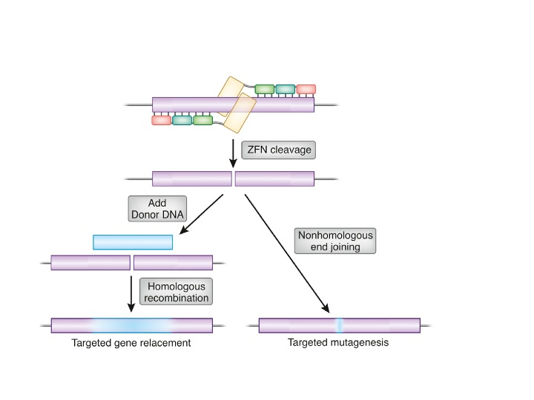

Slide 32
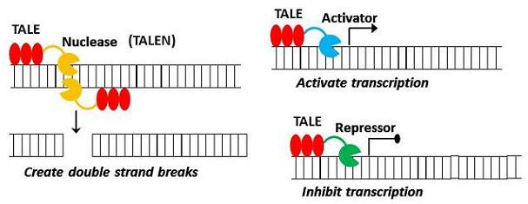
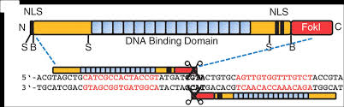
Transcription activator-like effector nucleases (TALEN)

Slide 33
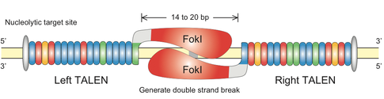
TALEN
TAL effectors are proteins that are secreted by Xanthomonas bacteria when they infect plants.

Slide 34


The CRISPR (clustered regularly interspaced short palindromic repeats) system
Cas (CRISPR-associated sequences) proteins
CRISPR
Cas9
DNA loci containing short repeats, which are separeted by spacer sequences. These loci are frenquently closely linked with Cas genes.
CRISPR loci can be found in 90% of Archaea and in 40% of Bacteria.

Slide 35


Endogenous defense against viral (phage) elements

Slide 36

baktérium
Virális DNS

Slide 37

Emmanuelle Charpentier and Jennifer Doudna

Slide 38


Slide 39

PAM: Protospacer adjacent motif (behing DNA sequence targeted by Cas9)
crRNA: CRISPR RNA
tracrRNA: trans-activating crRNA, a small trans-encoded RNA

Slide 40


Generation of deletional alleles by the CRISPR-Cas9 system
Cas9

Slide 41


Slide 42

Cas9 homologues

Slide 43

Genome-editing knockout kit using CRISPR/CAS9

Slide 44


Slide 45



Slide 46


Slide 47


Slide 48



Slide 49


Slide 50


Knockout, knockin by CRISPR-Cas9

Slide 51
A CRISPR-Cas9-based autocloning system
No need for enzymatic reactions

Slide 52
checking

Slide 53
testing

Slide 54


Slide 55


Slide 56

Isothermal PCR + nicase enzyme

Slide 57

Solution: „home” DNA diagnosis

